Slide 1

Replication study - Doireanna Craven
Coalition mood in European parliamentary democracies
Imre, Michael; Ecker, Alejandro; Meyer, Thomas M.; Müller, Wolfgang C.
2022
https://doi.org/10.7910/DVN/FEQSC7, Harvard Dataverse, V1

Slide 2
Abstract (extract)
EXPLAINING THE ORIGINAL STUDY
“The success and longevity of coalition governments depends on the ability to keep conflicts between coalition members at bay. ... This article presents a new approach to measuring the atmosphere between government parties. The ‘coalition mood’ is a time-varying measure that draws on applause patterns between coalition partners during legislative debates.” (Imre et al., 2022)

Slide 3
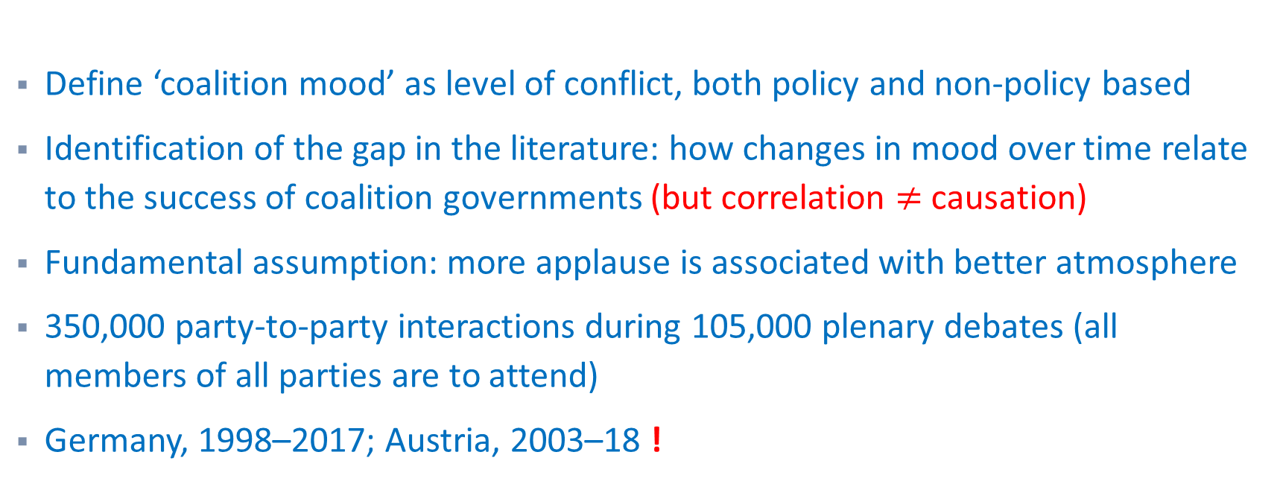
Details of the original study
EXPLAINING THE ORIGINAL STUDY
Define ‘coalition mood’ as level of conflict, both policy and non-policy based
Identification of the gap in the literature: how changes in mood over time relate to the success of coalition governments (but correlation $≠$ causation)
Fundamental assumption: more applause is associated with better atmosphere
350,000 party-to-party interactions during 105,000 plenary debates (all members of all parties are to attend)
Germany, 1998–2017; Austria, 2003–18 !

Slide 4
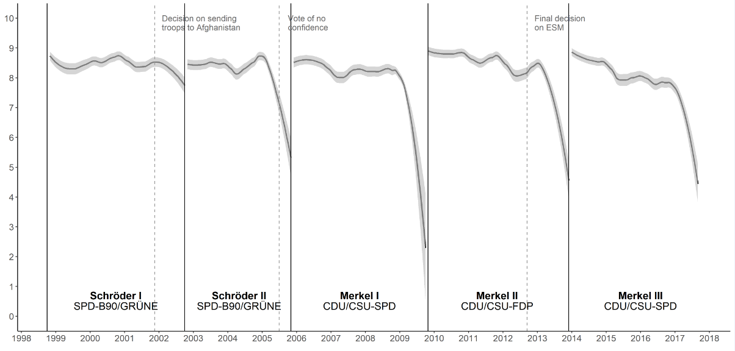
Example of outputs of the study
EXPLAINING THE ORIGINAL STUDY
One of the graphs presented in the original study shows that ‘Coalition Mood’, as measured by their definition of mood, follows electoral cycles.

Slide 5
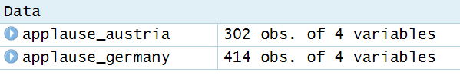
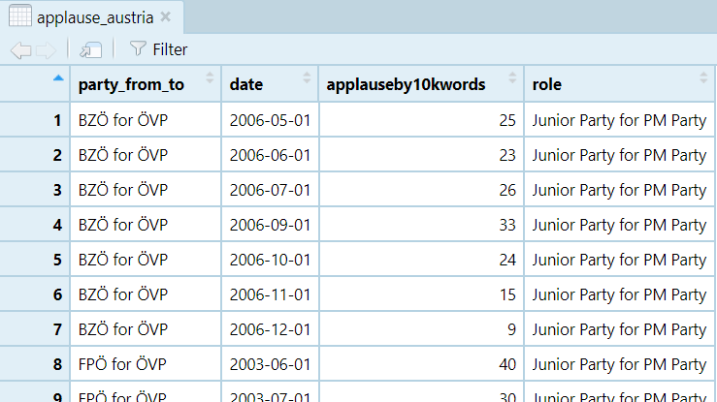
Data
EXPLAINING THE ORIGINAL STUDY

Slide 6
MY CONTRIBUTION
“To measure the coalition mood, we model applause for government parties in the legislature as a negative binomial process […] the negative binomial model is based on the log-transformed applause patterns (rather than raw frequencies) to account for the fact that additional applause should have a higher impact on the mood if the overall frequency of applause is rather low.”
My contribution: Confirm that a negative binomial model is more appropriate than a Poisson model, i.e. over-dispersion is present (variance > mean).

Slide 7
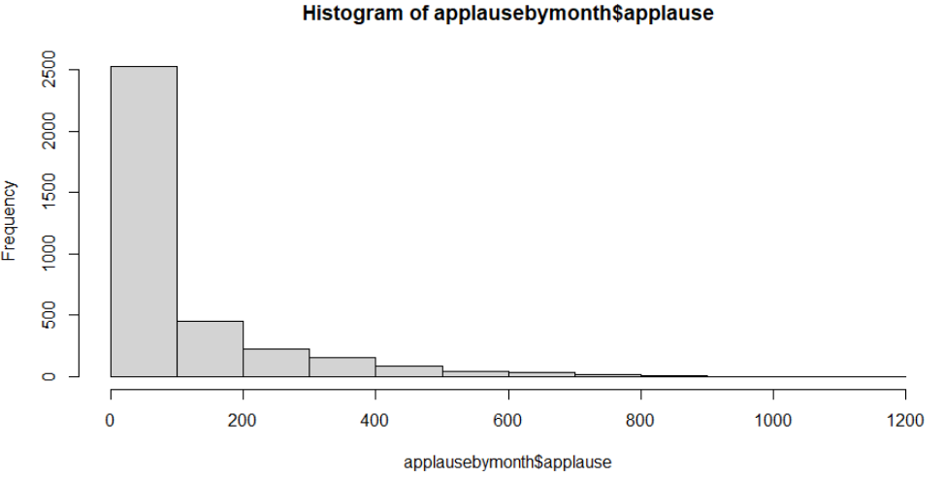
Distribution of applause
MY CONTRIBUTION Poisson or Negative Binomial?
Conclusion: Clearly a Poisson/negative binomial model will be appropriate here

Slide 8
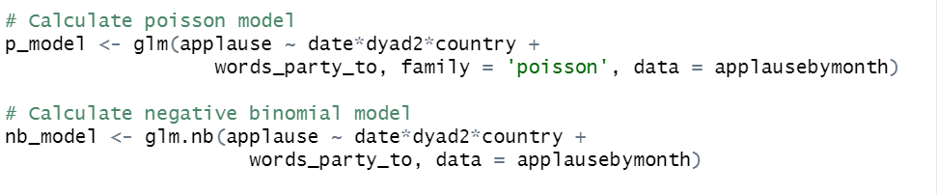
Poisson and negative binomial models
MY CONTRIBUTION Poisson or Negative Binomial?

Slide 9
Likelihood ratio test using Chi-squared
MY CONTRIBUTION Poisson or Negative Binomial?
Conclusion: negative binomial is better, but can I get a p-value?

Slide 10

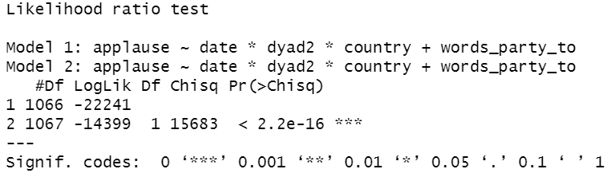
Likelihood Ratio test using lrtest
MY CONTRIBUTION Poisson or Negative Binomial?

Slide 11

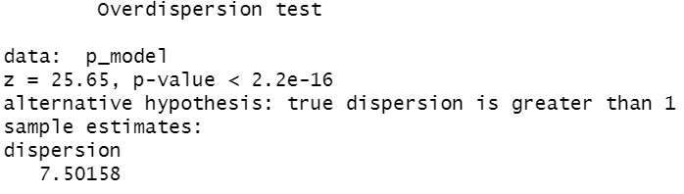
Dispersion test
MY CONTRIBUTION Poisson or Negative Binomial?
Conclusion: Overdispersion, response variance is greater than the mean, so don’t use Poisson.

Slide 12
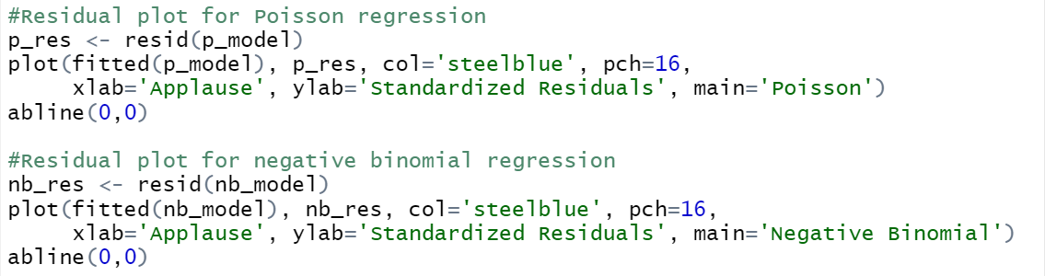
Plot residuals for both models
MY CONTRIBUTION Poisson or Negative Binomial?

Slide 13
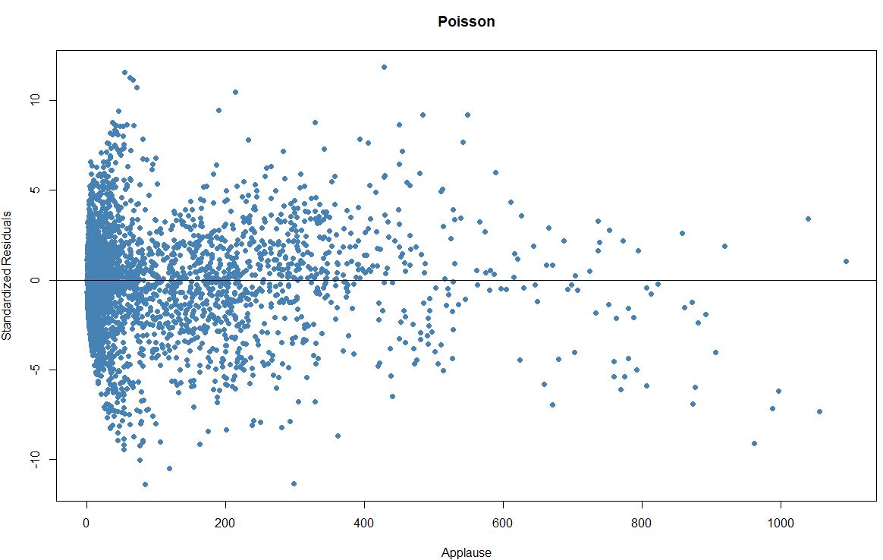
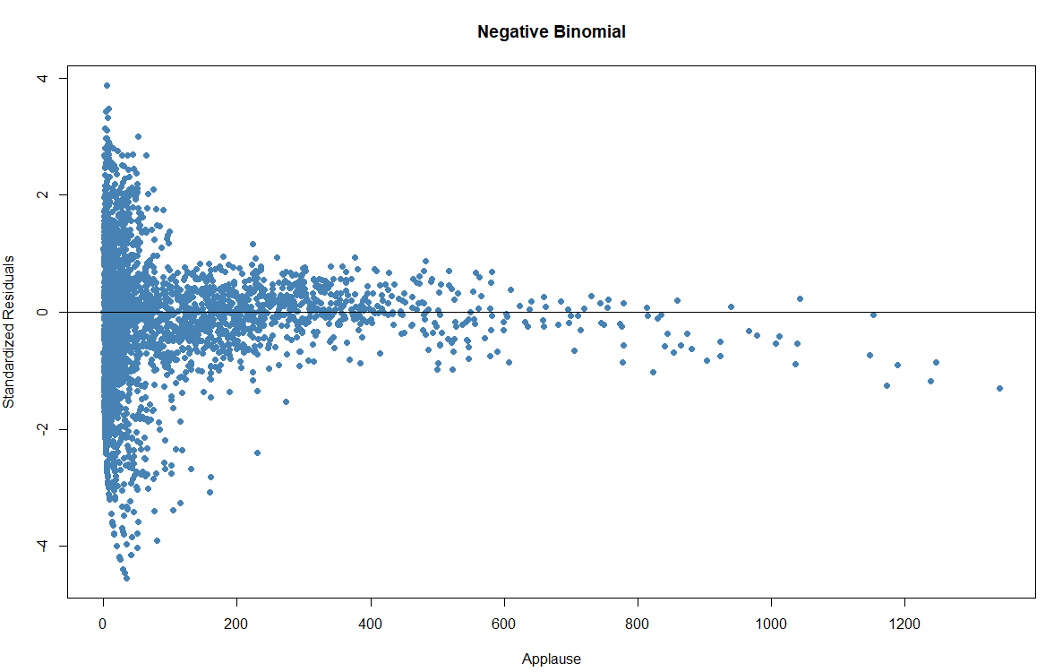
MY CONTRIBUTION Poisson or Negative Binomial?
Conclusion: residuals are smaller for Negative Binomial model, therefore it is a better model than Poisson for this data.
The non-random nature of the residuals reflects the heteroskedasticity predicted by the author of the original paper.

Slide 14
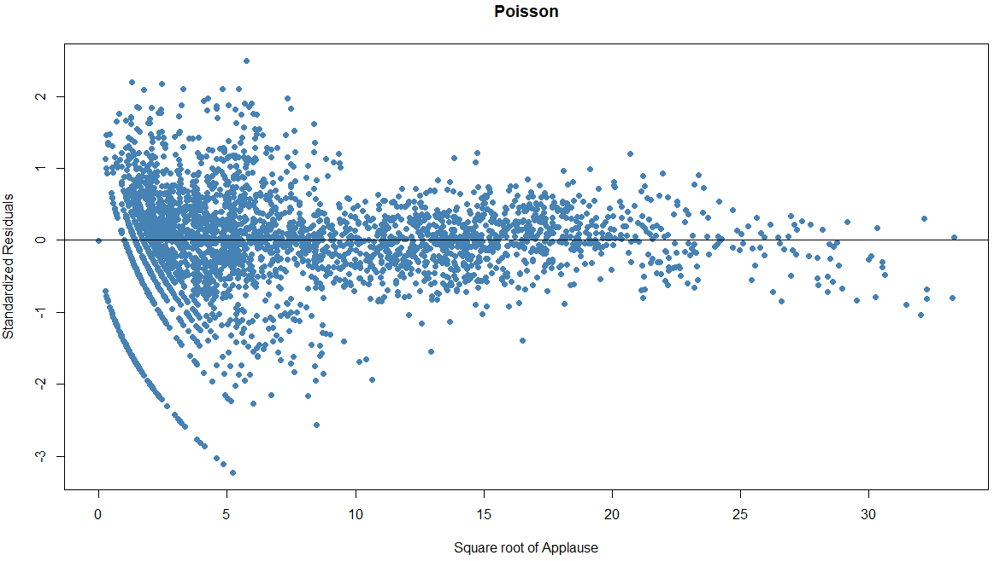
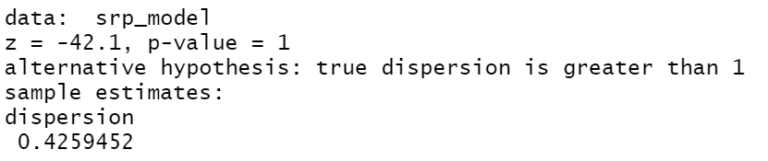
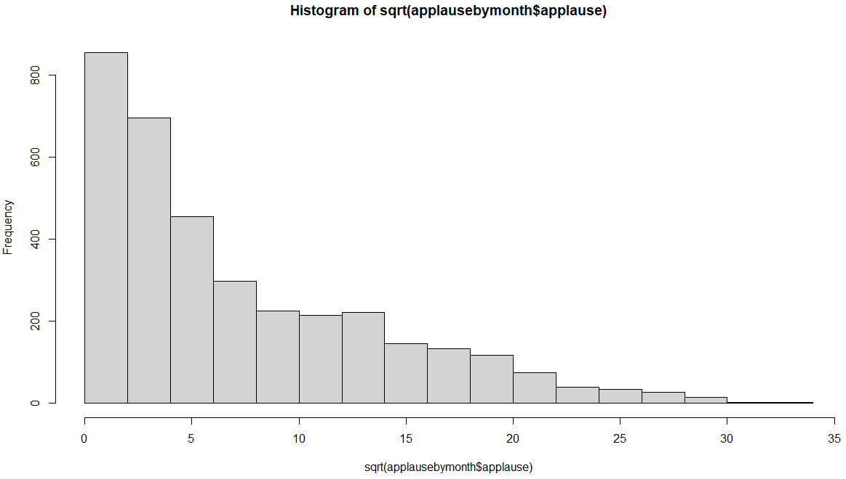
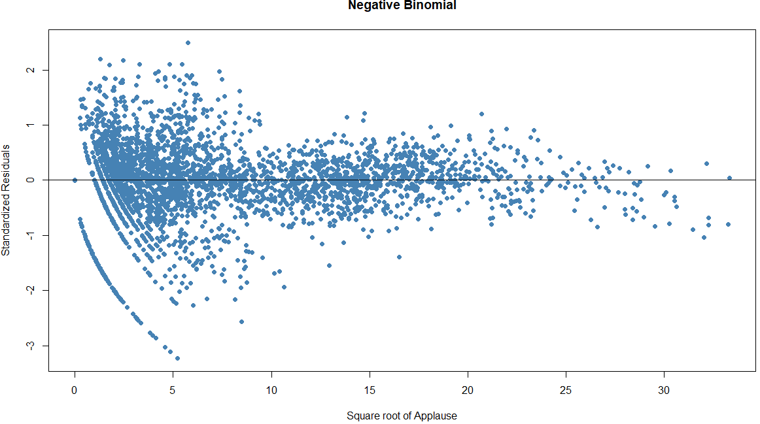
Square root of Applause
DISCOUNTED EXPLORATION
Conclusion: Under-dispersion – variance is now less
than the mean. But this is just a result of the transformation.

Slide 15
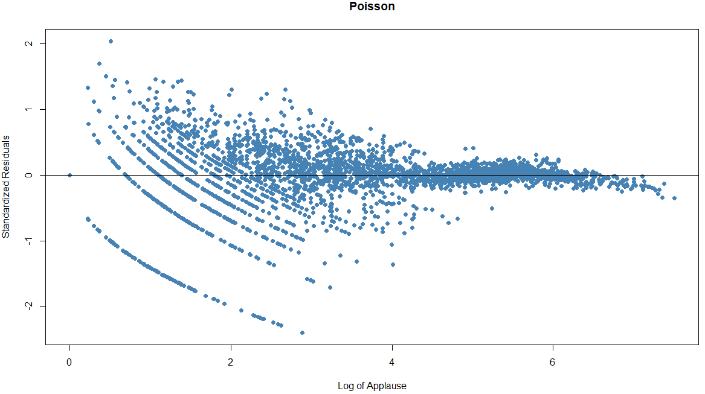
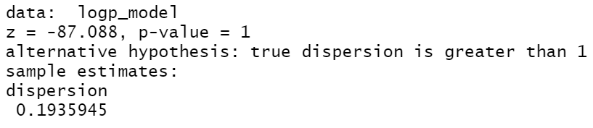
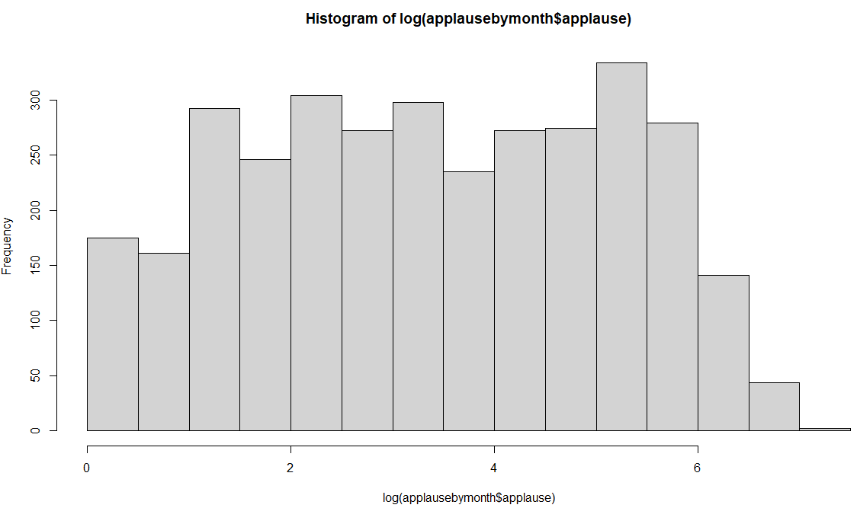
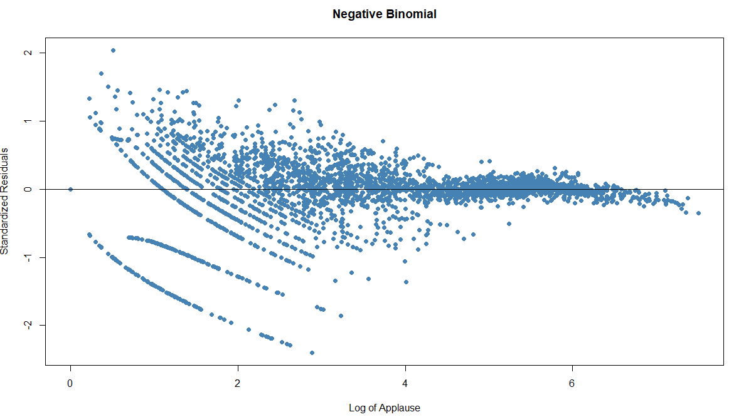
DISCOUNTED EXPLORATION
Log of Applause
Again this merely reflects the transformation.

